Slide 1
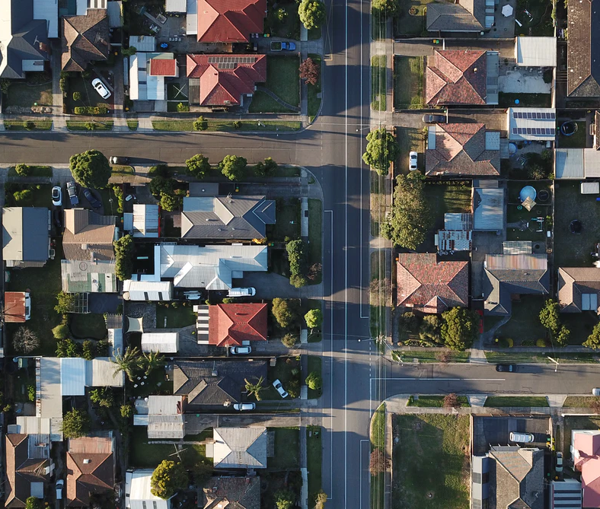
Analysis of Ames Housing data: Comparing Value of Cosmetic Features with Descriptive Modeling

Slide 2
Who We Are:
We are an IT-KASA (International Team KASA) organization tasked to evaluate Ames marketplace data and predict the price difference if certain cosmetic features were implemented.
Team Members:
- Khamanna
- Ariel
- Shay Agarwal
- Ava

Slide 3

Exploratory Data Analysis

Slide 4
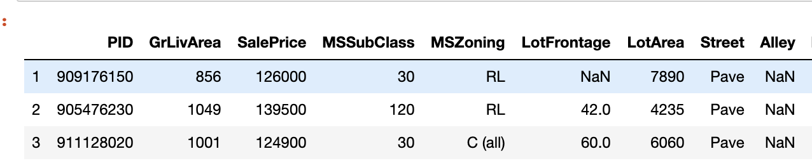
Exploratory Data Analysis:
 | Missing
PoolQC | 2571
MiscFeature | 2483
Alley | 2412
Fence | 2055
FireplaceQu | 1241
LotFrontage | 462
GarageFinish | 129
GarageQual | 129
GarageCond | 129
GarageType | 127
BsmtExposure | 71
BsmtFinType2 | 70
BsmtFinType1 | 69
BsmtCond | 69
BsmtQual | 69
MasVnrArea | 14
MasVnrType | 14
BsmtFullBath | 2
BsmtHalfBath | 2
Electrical | 1
BsmtUnfSF | 1
BsmtFinSF2 | 1
BsmtFinSF1 | 1
GarageCars | 1
TotalBsmtSF | 1
Remove Duplicate Rows
Remove Irrelevant observations – removed “PID”
Create a list of Variables with Missing Values and Cleaned It

Slide 5
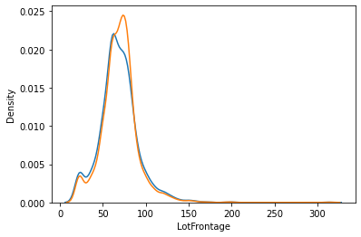
Exploratory Data Analysis:
” LotFrontage” distribution change after imputation
Impute Missing Values:
Impute Missing LotFrontage Values
Confirm the distribution of 'LotFrontage’ did not change significantly
Impute Missing Basement related Values
Impute Missing GarageArea and GarageCars Values
Impute Missing Electrical Values
Impute Missing MasVnrType and MasVnrArea Values
Check for Data Consistency: BsmtExposure (Basement Exposure)

Slide 6
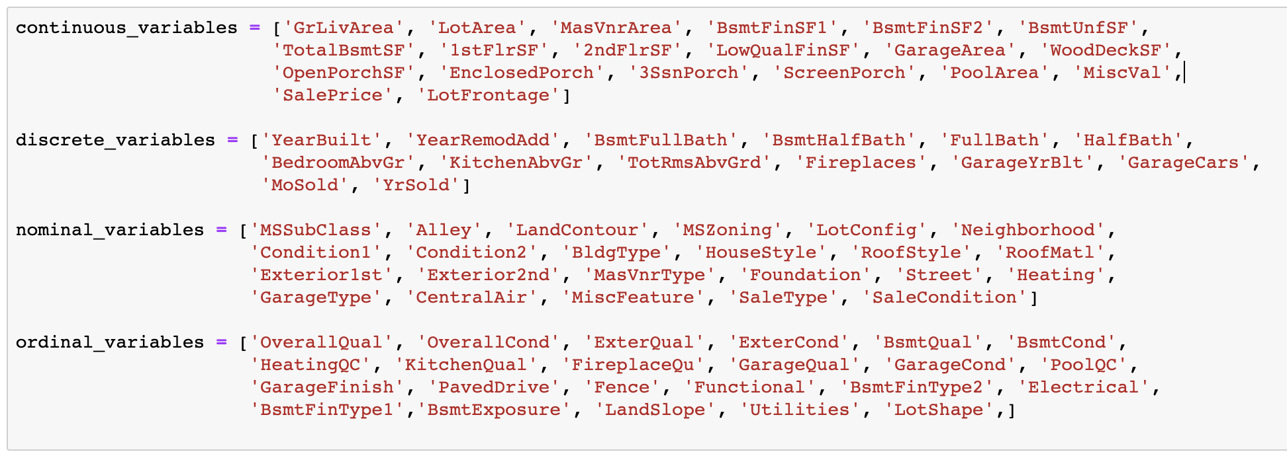
Exploratory Data Analysis:
Grouping Variables by type:
Continuous Variables
Discrete Variables
Nominal Variables
Ordinal Variables

Slide 7
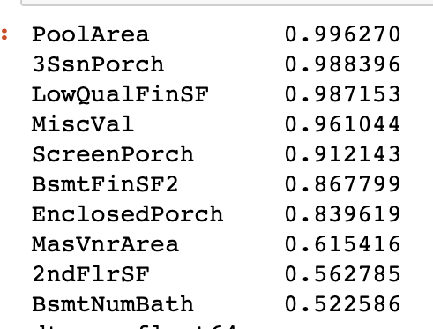
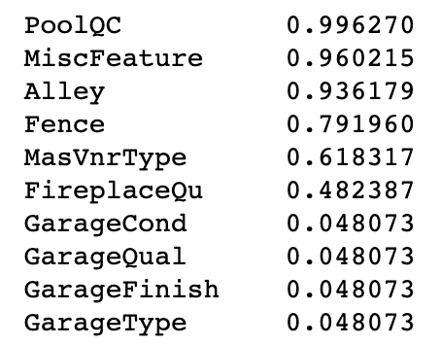
Exploratory Data Analysis:
Removed Nominal Variables With Less Than 10% of Unique observations (left)
Removed Numeric Features With Less Than 20% of Unique Observations (right)

Slide 8
Exploratory Data Analysis:
Generated New Features
Combined Number of Bathrooms in the Basement: “BsmtFullBath” and “BsmtHalfBath”
Created Cost Per Square-Foot (pic of the dataset with the said features)

Slide 9
Exploratory Data Analysis:
Removed Abnormal Sales
Included sales that were completed under 'normal' circumstances. The other type of sales (foreclosure, short sale, etc...) only account for 6% of the observations and are outside the scope of this work.( Insert code)

Slide 10
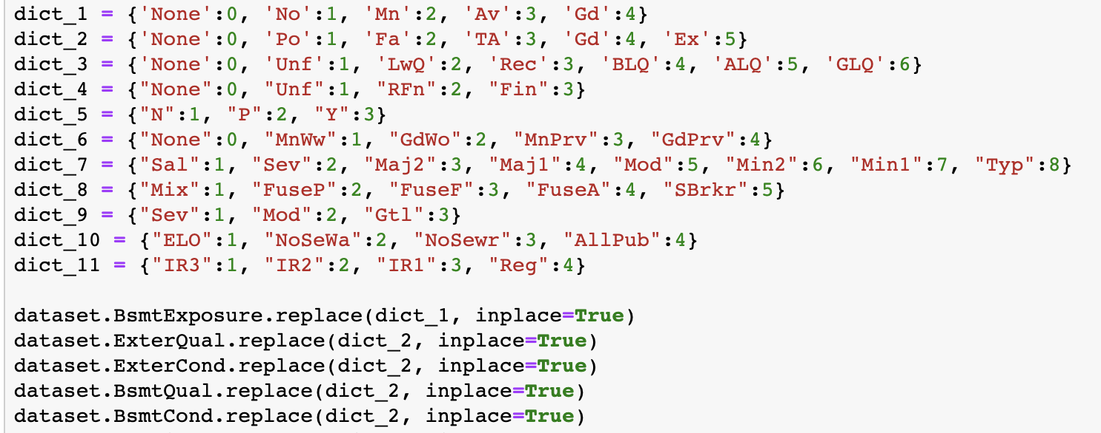
Exploratory Data Analysis:
Converted Ordinal Variables to Numeric

Slide 11
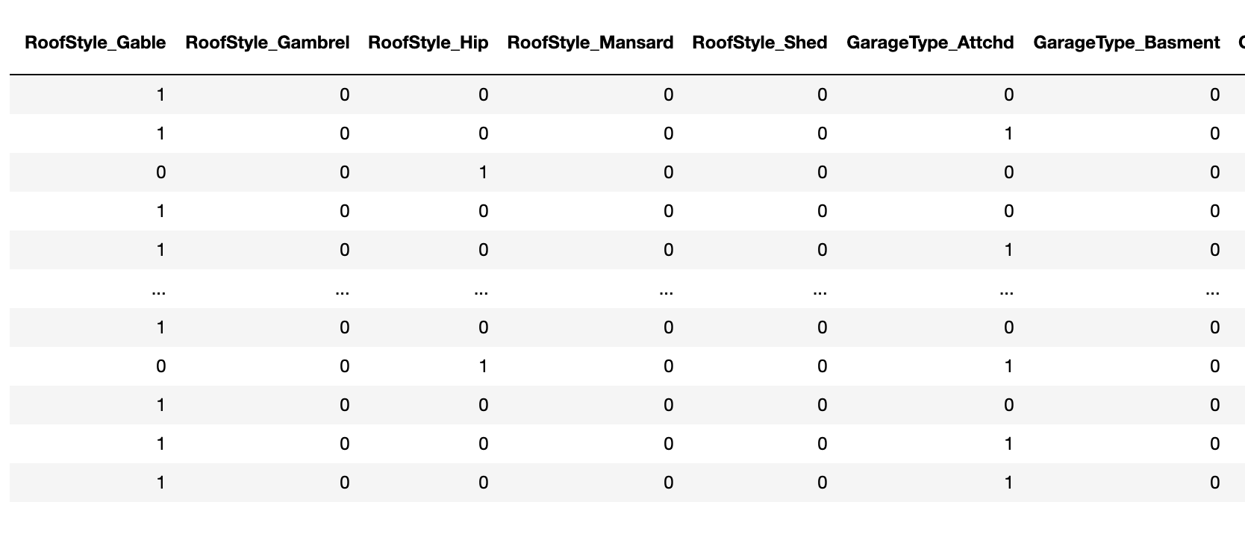
Exploratory Data Analysis:
Dummified Nominal Variables

Slide 12
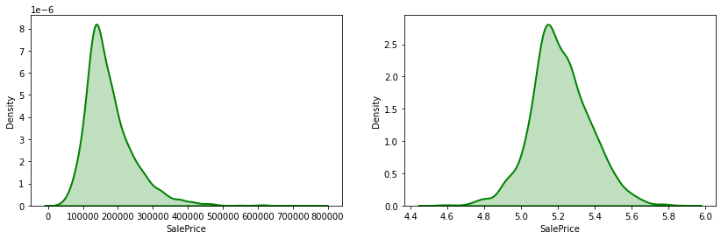
Exploratory Data Analysis:
Checked for Normality: Dependent Variables

Slide 13
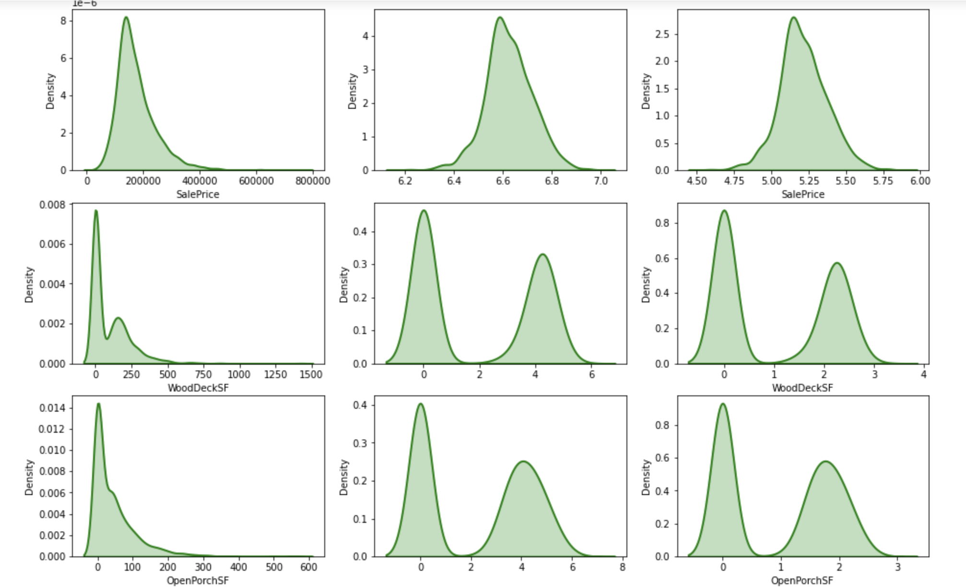
Exploratory Data Analysis:
Checked for Normality: Independent Variables

Slide 14
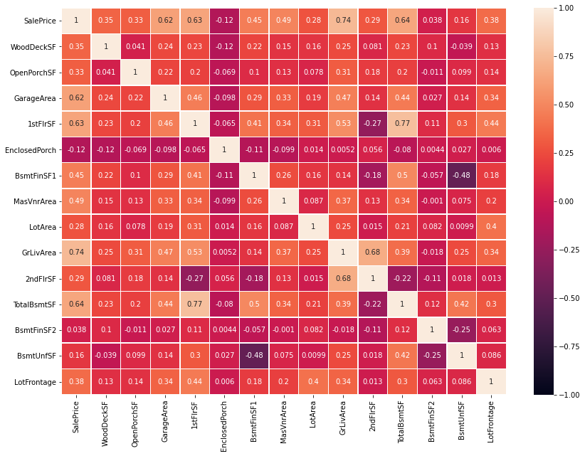
Exploratory Data Analysis:
MultiCollinearity: Correlation Matrix for Continuous Variables
Correlation Against Target Variable (SalePrice):
 | SalePrice
SalePrice | 1.000000
GrLivArea | 0.736036
TotalBsmtSF | 0.642354
1stFlrSF | 0.634672
GarageArea | 0.621900
MasVnrArea | 0.486620
BsmtFinSF1 | 0.454087
LotFrontage | 0.382420
WoodDeckSF | 0.350127
OpenPorchSF | 0.326489
2ndFlrSF | 0.293338
LotArea | 0.275066
BsmtUnfSF | 0.159724
EnclosedPorch | 0.117988
BsmtFinSF2 | 0.038346

Slide 15
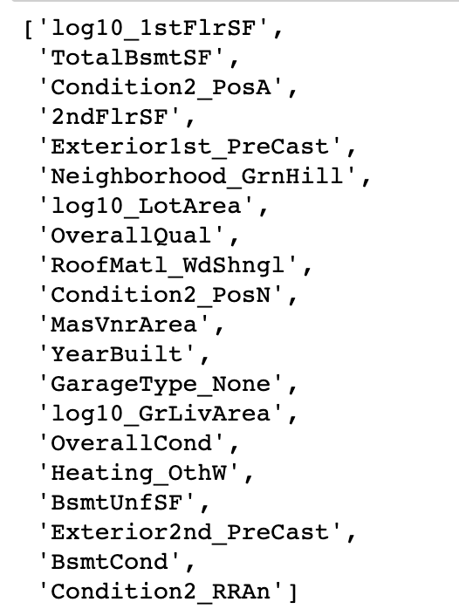
Exploratory Data Analysis:
We used Lasso to determine which features will go into our model

Slide 16
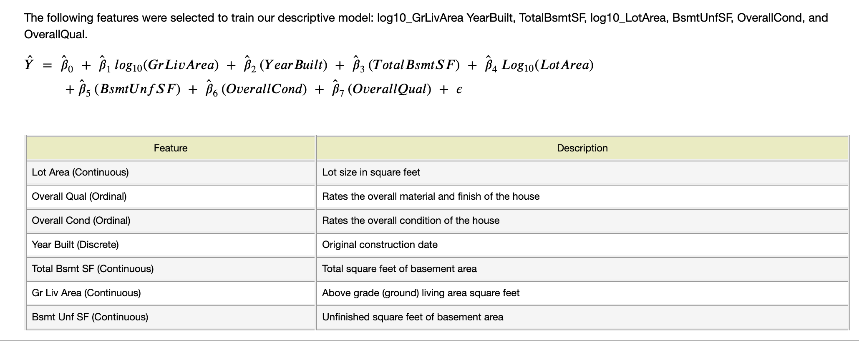
Exploratory Data Analysis:
We used Descriptive Model for our study

Slide 17
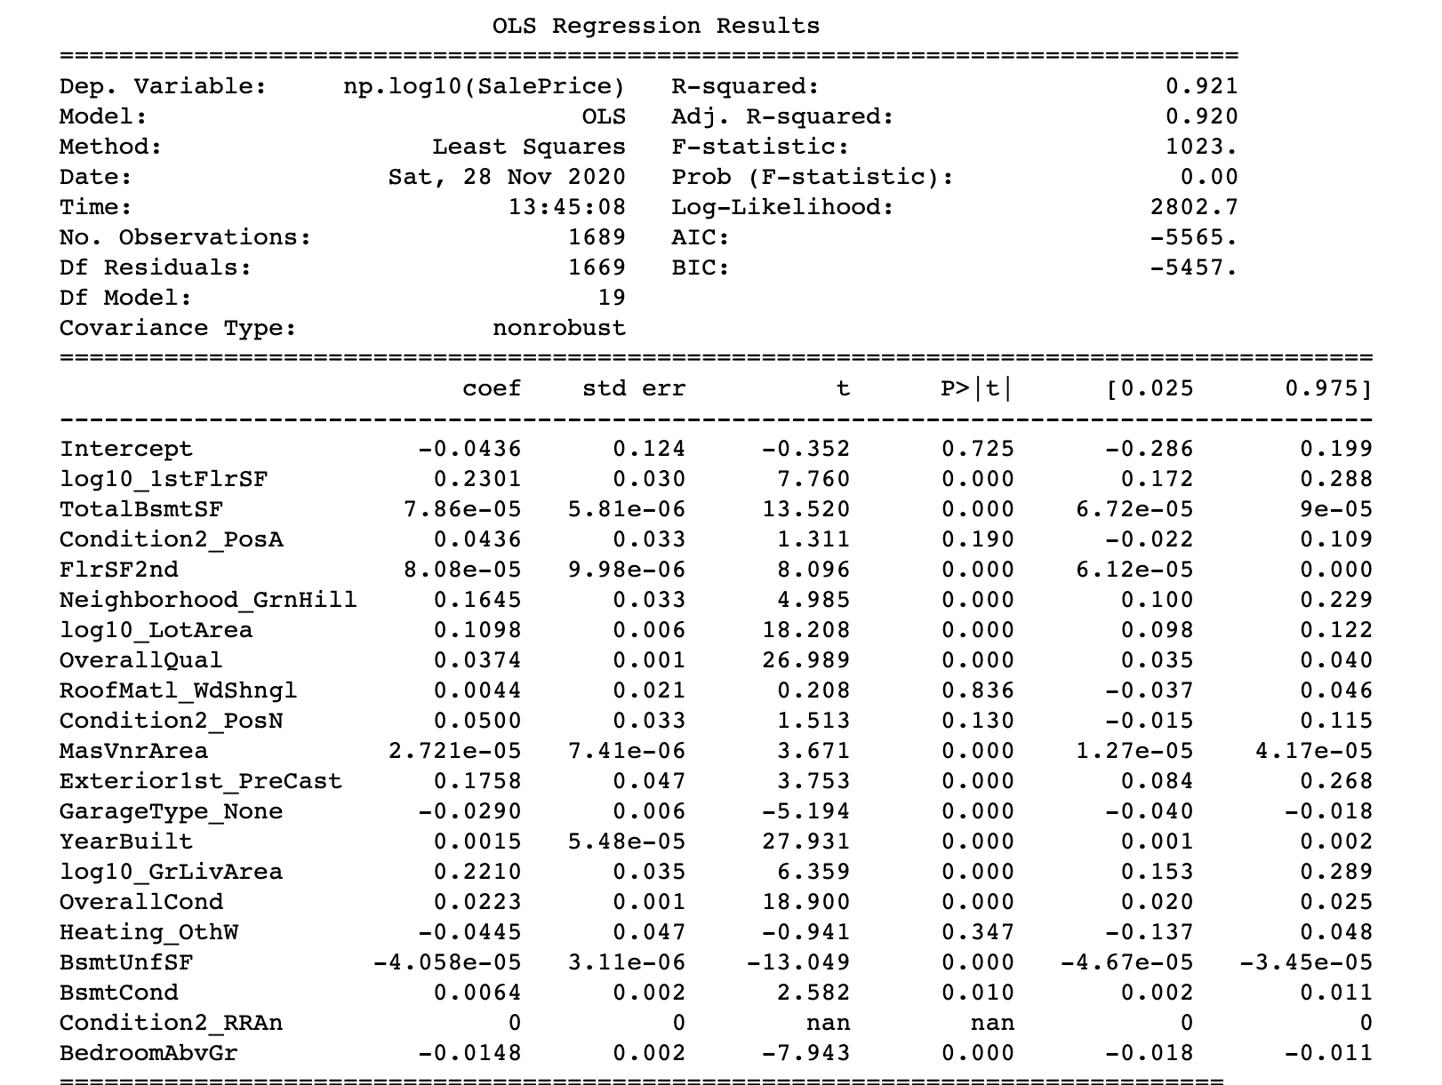
Exploratory Data Analysis: We evaluated p-values and R-squared using Statmodel to examine the significance of features

Slide 18
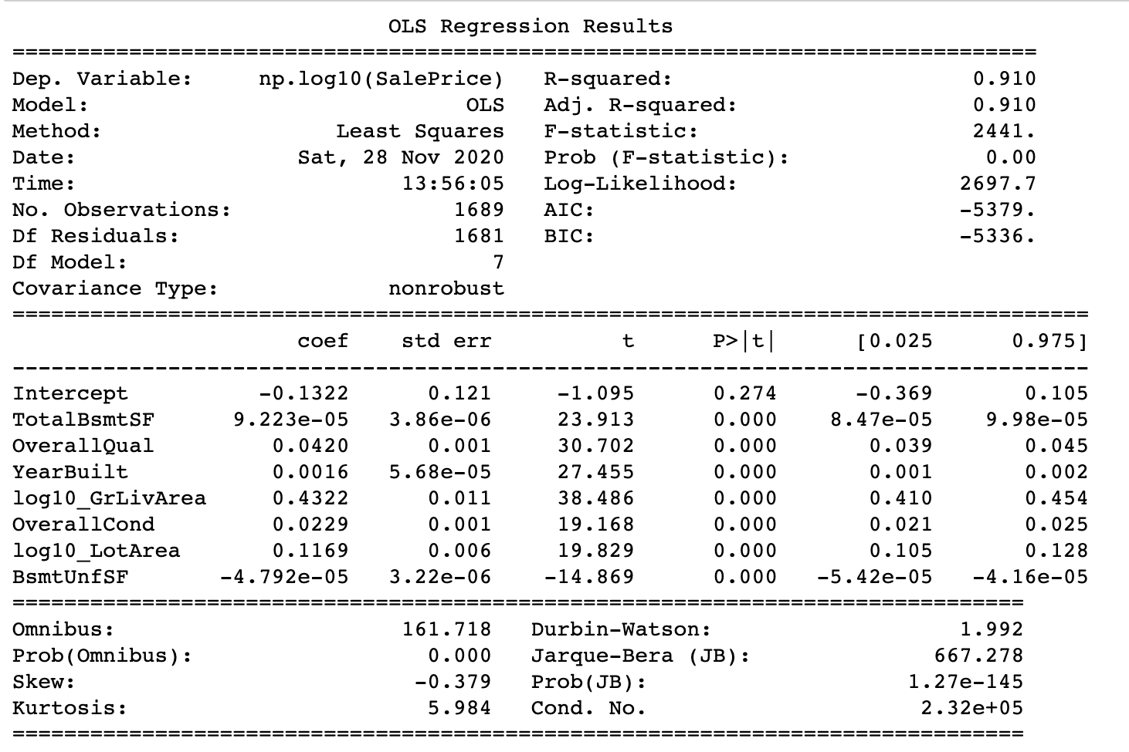
We narrowed the number of features to 7
Exploratory Data
Analysis:

Slide 19
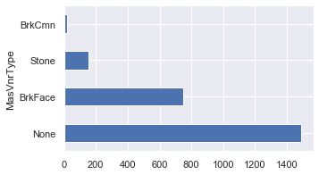
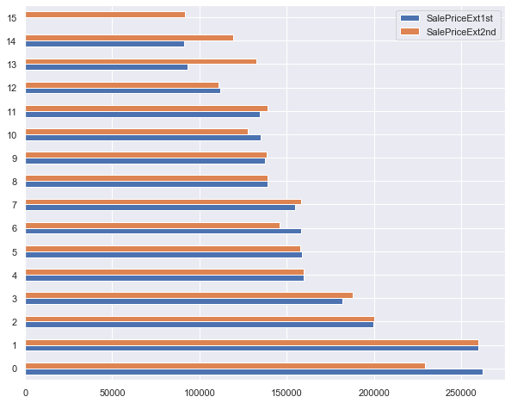
Exterior
In columns such as MasVnrType and MasVnrArea (Mason Veneer Type and Mason Veneer Area) the majority of the data appears as None and therefore doesn’t carry much significance. Exterior1st and Exterior2nd show similar yield when the typos in Exterior2nd are fixes. Typos were: ‘Wd Shng’ : ‘WdShng’, ‘CmentBD’ : ‘CemntBD’, ‘Brk Cmn’ : ’Brk Comm’

Slide 20
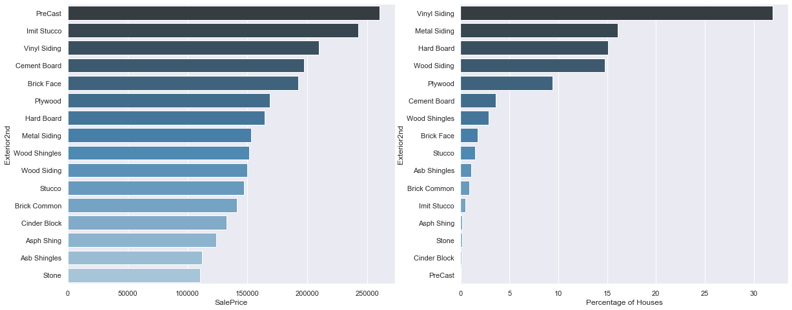
We selected to explore Exterior2nd feature deeper. The mean SalePrice per Exterior feature displayed on the left. The Percentage of Houses that have that Exterior material displayed on the right
We grab 10 houses with Plywood Exterior and use our model to predict the prices for these houses.
Next, we predict the prices for these same houses if they had Vinyl Exterior instead of Plywood.
Our model yields: 0.9158010328166403

Slide 21
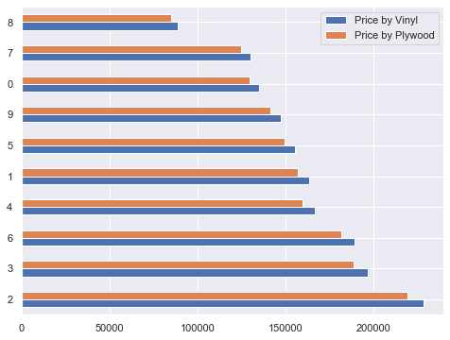
Again, we compare the predicted value of the houses with Plywood Exterior with predicted value of the same houses if they had Vinyl exterior as opposed to Plywood. Each house with Plywood exterior shows an increase in price if it had Vinyl exterior
 | Price by Plywood | Price by Vinyl | Difference
0 | 129287.19 | 134746.74 | 5459.55
1 | 156843.44 | 163466.64 | 6623.20
2 | 219061.00 | 228311.53 | 9250.53
3 | 188527.81 | 196488.98 | 7961.17
4 | 159762.70 | 166509.18 | 6746.48
5 | 149058.09 | 155352.53 | 6294.44
6 | 181585.60 | 189253.61 | 7668.01
7 | 124476.14 | 129732.53 | 5256.39
8 | 85087.79 | 88680.89 | 3593.10
9 | 141097.01 | 147055.27 | 5958.26

Slide 22
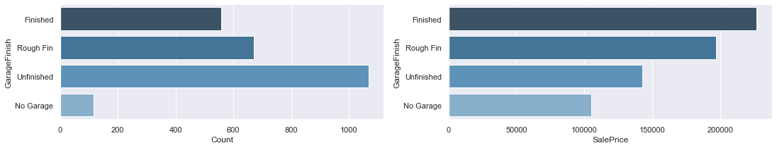
Garage
After a closer look at all Garage columns we chose to evaluating Garage Finish
The count of Finished, Rough Finish, Unfinished and No Garage displayed on the left. The mean Sale Price for Finished, Rough Finish, Unfinished and No Garage displayed on the right
By the same logic we grab 10 houses with Unfinished Garage and use our model to predict the prices for these houses. Next, we predict the prices for these same houses if they had Finished Garage instead of Unfinished.
Again, our model yields: 0.9154034290784837

Slide 23
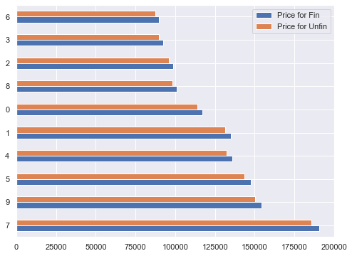
Below are the prices for houses with Unifinished Garages and predicted prices for the same houses if their Garages were Finished. The houses are predicted to increase in price if the Garages were Finished
 | Price for Unfin | Price for Fin | Difference
7 | 185629.90 | 190662.88 | 5032.98
9 | 150367.72 | 154444.64 | 4076.92
5 | 143491.54 | 147382.02 | 3890.48
4 | 132237.32 | 135822.67 | 3585.35
1 | 131259.17 | 134818.00 | 3558.83
0 | 113766.68 | 116851.23 | 3084.55
8 | 98434.30 | 101103.15 | 2668.85
2 | 96028.32 | 98631.94 | 2603.62
3 | 89853.38 | 92289.57 | 2436.19
6 | 87298.49 | 89665.41 | 2366.92

